Slide 1
HIF Grantee Training
FY24 Grant Cycle
September 21, 2023

Slide 2
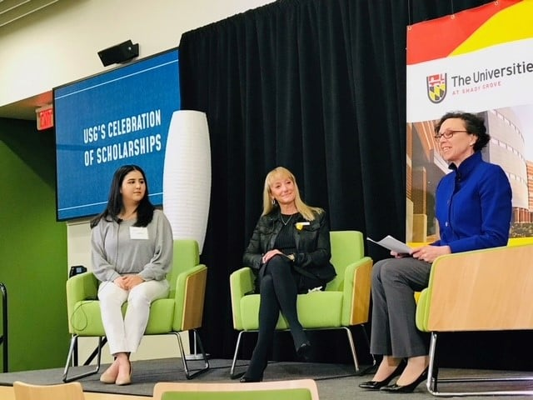
Agenda
New FY23 Strategic Plan
Foundation Strategic Goals & Actions
FY22 Impact of Investments
Overview of Eligibility
Grant Guidelines for Funding
Application Process and Deadlines
Draft Application for Capacity Building
Next Steps

Slide 3
Healthcare Initiative Foundation
2023 Strategic Plan
Vision
The vision of the Healthcare Initiative Foundation (HIF) is a community where all Montgomery County residents have access to high-quality, comprehensive health, wellness, and social services delivered in a culturally responsive, equitable manner.
Mission
To help achieve that vision, HIF supports innovative solutions in the delivery of health, wellness, and social services to help address social determinants of health, and to improve life expectancy.
Values
The values of the Healthcare Initiative Foundation - innovative, integrated, solutions-oriented guide - and inform ground the work and programs that the Foundation supports.

Slide 4
Healthcare Initiative Foundation
2023 Strategic Plan
Strategic Goals
Supporting affordable, integrated, culturally responsive health and wellness systems across the lifespan.
Supporting comprehensive behavioral health services across the lifespan.
Supporting stakeholder convenings and collaborations amongst stakeholders to increase effectiveness and improve accessibility to healthcare, wellness, and social services.

Slide 5
Healthcare Initiative Foundation
2023 Strategic Plan
Actions
Support innovative solutions and proof of concepts with stakeholders to improve community health and wellness
Engage in nonprofit coalition-building to facilitate cross-sector collaboration & improve health & wellness services (i.e., community impact assessments, integrated data collection, gap analysis for service delivery, community advocacy, etc.)
Invest time & resources to improve service delivery, accessibility, & encourage innovation
Invest in a culturally responsive & diverse health, wellness, & behavioral health provider network & services
Invest in innovative workforce development programs to increase the size of the health, wellness, & behavioral health workforce
Invest time & foundation resources supporting health, wellness, & behavioral health programs & services
Support emergent health, wellness, & behavioral health needs
Support integrated business and/or collective impact models for healthcare & wellness services

Slide 6
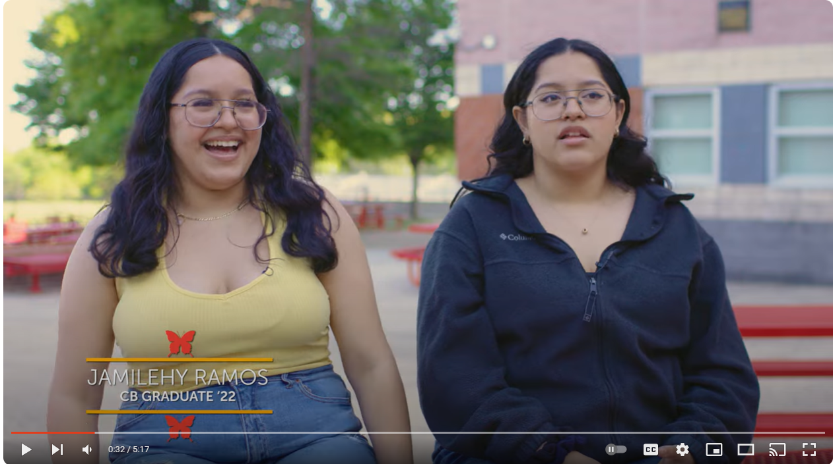
Storytelling Project
Community Bridges
Healthcare Initiative Foundation worked to highlight our FY22 Capacity Building grant partners’ programming, innovations, partnership.
https://hifmc.org/news/storytelling/
Warrior Canine Connection
Community Bridges, celebrating 25 years this year, empowers girls from diverse backgrounds to become exceptional students, positive leaders, and healthy young women. Their work follows the young women and their families from 4th grade through 12th grade!
Check out this heartwarming story about how WCC's Jack is helping Ben with both his visible and invisible wounds. #warriorstories

Slide 7
FY22 Year End Investment Portfolio for Capacity Building
Total Amount Awarded in FY22 $1.02M

Slide 8
Eligibility for Grant Funding
Start or grow well-conceived programs/organizations;
Offer innovative solutions to improve the quality, accessibility and/or delivery of healthcare;
Replicate successful (evidence based) programs from our own or other jurisdictions;
Serve HIF’s strategic, place-based and population priorities;
Build organizational capacity to enhance sustainability and/or improve service deliver; and
Leverage resources, whether human or financial (e.g. revenue, partnerships, matching or aligned funds).

Slide 9
Grantee Trainings and Site Visit
Has your organization attended a grantee training in the last year?
If you are a new applicant to HIF, has your organization had a site visit with HIF staff?
Good News – this webinar (live or recorded) counts as a training
This can be as easy as a virtual meeting. It allows us the opportunity to get to know you!

Slide 10
Lenses to Use When
Developing Your Application

Slide 11
Collective Impact Models
Cross-sectoral Initiatives
Equity, Diversity, and Inclusion
Targeted, Placed-based Initiatives
Public-Private Partnerships
Proof of Concept for Scalability

Slide 12
Project Examples
Collective Impact
Universities at Shady Grove & Montgomery College, Hospitals, Nonprofits
Cross Sectoral
Fresh Produce Advanced Contract Purchasing Pilot
Food is Medicine
Social Determinants
Placed-based
Public-Private
Healthcare Workforce Development
Food Access
Housing for Homeless Prenatal Moms
Thriving Germantown
Mobile Dental and Vision Clinics
Vision Exams in ES with NPs, DHHS, & MCPS
Vaccine Administration
Montgomery Moving Forward
Poolesville Collaborative
Proof of Concept for Scalability
Nonprofit
Service Hub
Identity Program
Trauma Responsive
Ecosystem (TRE)
Serving Together
Partners In Care
Notes:
Slide 11 : 1) collective impact is TG and MMF (multiple funding streams from different sectors coming together for a collective goals), 2) cross sectoral add vision clinics at schools and add Food as medicine, 3) Place based add JSSA here

Slide 13
Goal, Objective, & Impact
Impact is more than a number that can be measured. What is the overall change you anticipate seeing because of this programming?
When the grant year is over, how will you know your work has been successful.
Goal
Objectives

Slide 14
Rubric for Review of Applications
Invest
Invest in Historically Underinvested Communities – are they planning to serve priority communities?
Promote
Promote Race, Equity and Inclusion – is their organization and project taking into consideration equity in programming, equity in leadership and employee pay, and equitable access to services?
Offer
Offer Cross-sectoral and/or Multi-year approaches – does the project explain how it will address the facets of social determinants of health?
Support
Support HIF’s Strategic Priorities – does the project align with HIF’s mission, values, and strategic goals?
Build
Build Equitable Systems, Community and Programs

Slide 15
FY23 Zip Code Tracking Data
Provide your best estimate on where you predict your requested grant amount will allocated based on Montgomery County’s Service Regions and Zip Codes (see map).
We will only be requesting estimates on the 10 historically underinvested zip codes
Providing this information to the best of your ability will reflect in the application’s rubric scores during review

Slide 16
Historically Underinvested Zip Codes

Slide 17
FY22 Zip Code Spending – Capacity Building
In FY22, grant partners estimate they will invest at least 83% of HIF’s dollars towards historically underinvested communities in Montgomery County.

Slide 18
Self-Sufficiency Calculator
Utilize the Montgomery County 2023 Self-Sufficiency Standard Data to Guide Investments: 1) Stabilizes the Nonprofit Workforce; 2) Improves continuity of care; 3) Addresses pay inequities in the sector; and 4) Counters the belief that nonprofits can do more for less.
Maryland Self-Sufficiency Standard Calculator
https://maryland-cap.org/the-maryland-2023-self-sufficiency-standard-calculator/
REPORT
https://selfsufficiencystandard.org/wp-content/uploads/2023/08/MD2023_SSS.pdf
The 2023 Montgomery County, MD Self-Sufficiency Standard Report
A comprehensive analysis of Montgomery County SSS data!
https://www.montgomerycountymd.gov/CommunityAction

Slide 19
How Much is Enough in Montgomery County? The Self-Sufficiency Standard calculates how much income families of various compositions need to make ends meet without public or private assistance, varied by county.

Slide 20
How Much is Enough in Montgomery County? The Self-Sufficiency Standard calculates how much income families of various compositions need to make ends meet without public or private assistance, varied by county.

Slide 21
How Does the Standard Compare?

Slide 22
Application Preview – Comments Welcomed Until Thursday, September 28th elissa.schwartz@hifmc.org

Slide 23
Grants reviewed through December.
If necessary, discussions with grant applicants in January.
Grant notification Feb/March 2024
Reach out to HIF staff with questions
Consider what you want to apply for
Ensure your organization has access to our grant portal (Foundant)
Grant application will close Monday, November 20th at 5pm EST
Application will open Friday, Oct 6th at 9am EST
Application will close Monday, November 20th at 5pm EST

Slide 24
Grant Portal Process
Grant Portal (Foundant)
Does your organization have an account already?
If yes, DO NOT create a new account. You may need/want to add a new user within an account. If unsure, reach out and ask!
This year there will be just 1 application to consider – FY24 Capacity Building
Consider which FY24 Strategic Goal your request fits best
Any questions regarding the portal can be directed to Elissa Malter Schwartz (Lis) at Elissa.Schwartz@hifmc.org.
Tips from a grantee:
Print out questions in advance
Click save often
Complete application in word first and then cut and paste
Notes:
Print out questions in advance
Click save often
Complete application in word first and then cut and paste

Slide 25
Grant Requirements
Budget Documentation
Mid Year and Year End Report
Historically Underinvested Zip Code Data
Grantee Training & Site Visit
Clear Goals & Metrics

Slide 26
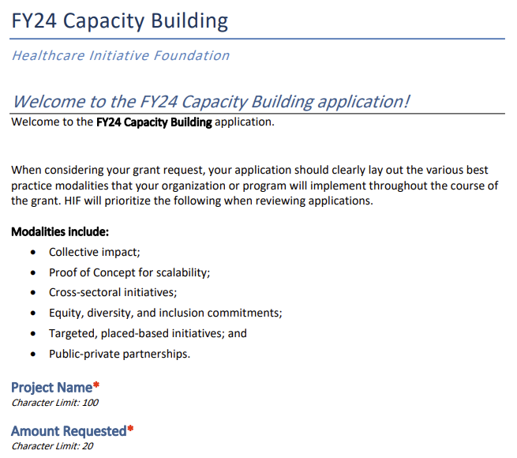
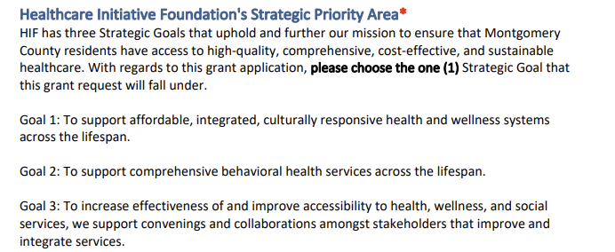
Draft Application FY24
Page 1

Slide 27
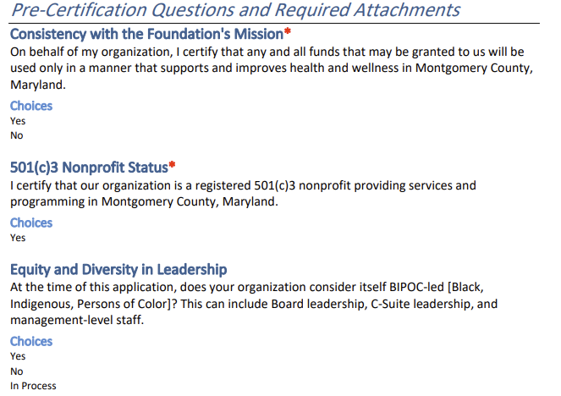
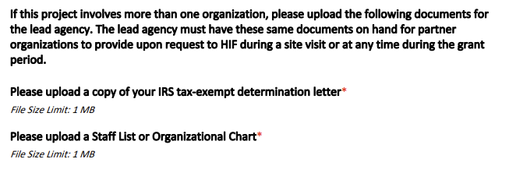
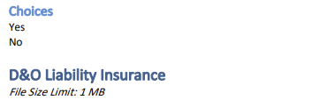
Draft Application FY24
Page 2 -3

Slide 28
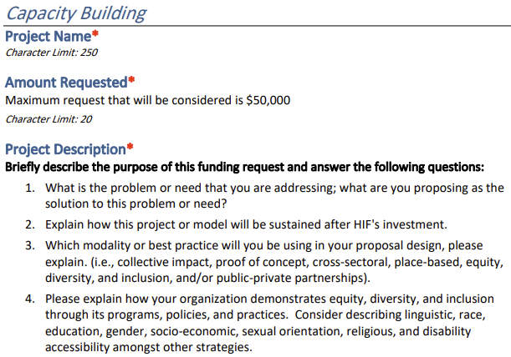
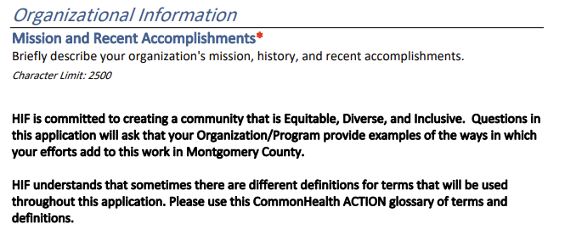
Draft Application FY24
Page 3 - 4

Slide 29
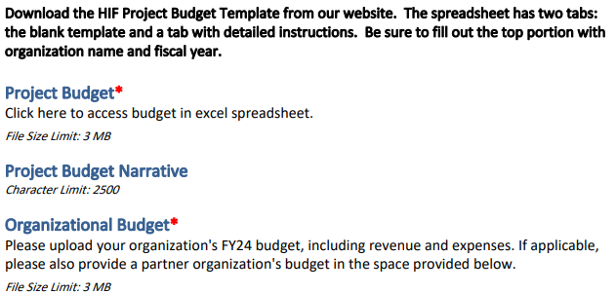
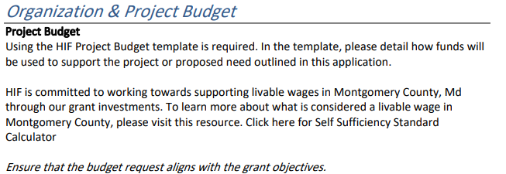
Draft Application FY24
Page 4 - 5
Minimum Self-Sufficiency Wage in MoCo
Individuals | Hourly | Yearly
1 Adult | $22.39 | $47,294
1 Adult & 2 Teens | $31.80 | $67,162
1 Adult & 1 School Aged Child | $37.73 | $79,683
1 Adult & 1 Preschooler & 1 School Aged Child | $55.33 | $116,864

Slide 30
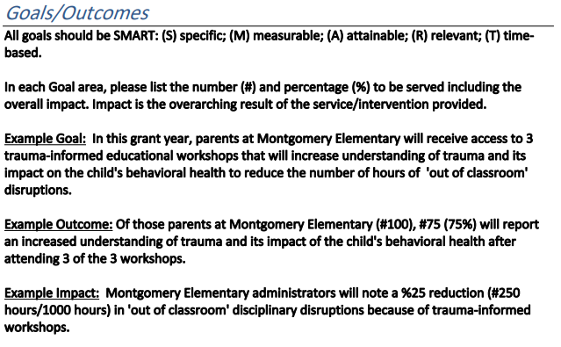
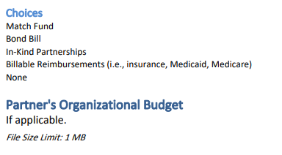
Draft Application FY24
Page 5 - 6

Slide 31
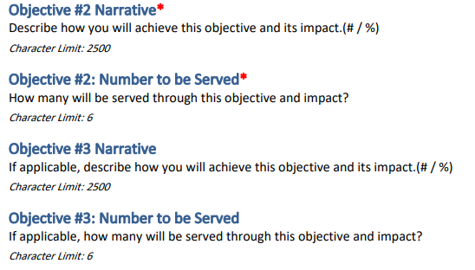
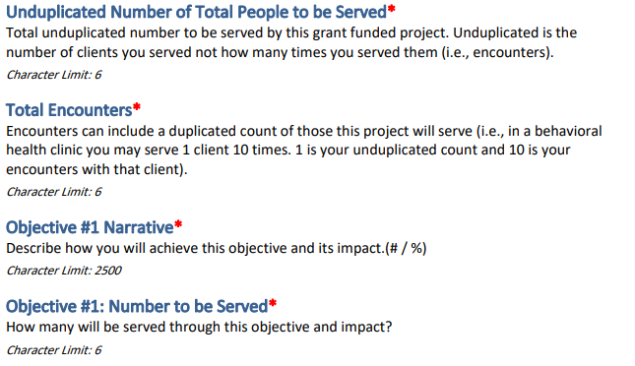
Draft Application FY24
Page 6 - 7

Slide 32
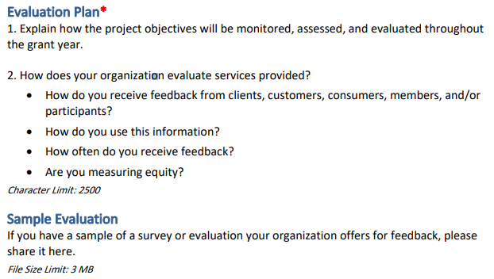
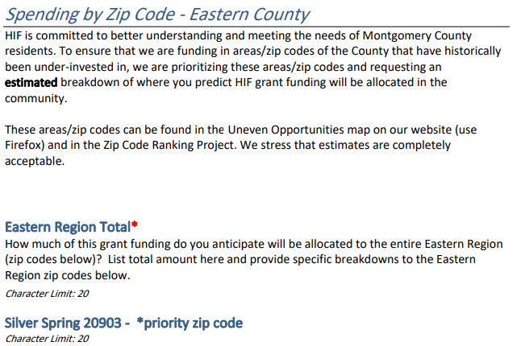
Draft Application FY24
Page 8

Slide 33
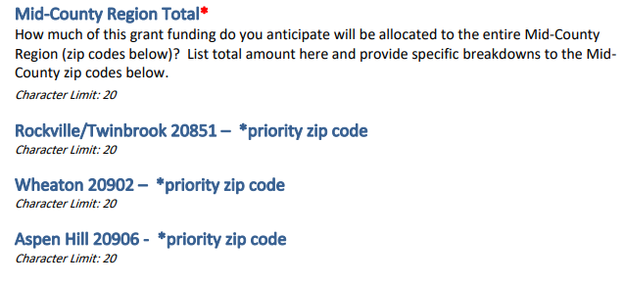
Draft Application FY24
Page 9 -10

Slide 34
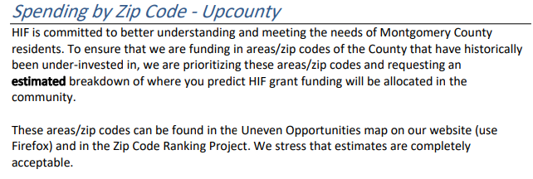
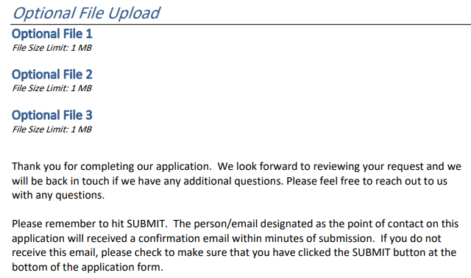
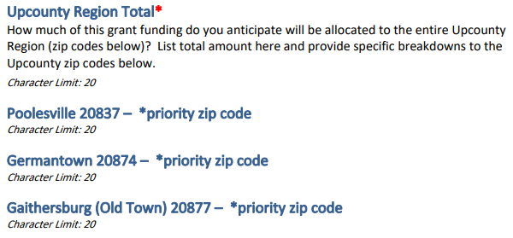
Draft Application FY24
Page 10 -11

Slide 35
Partner Presentation
FY23 Grant: Equitable Access to Mental Healthcare Workforce Careers
Amse Heck, Chief Development Officer
Marcela Compagnet-Orellana, Director, Human Resources

Slide 36
Achieving shared goals through shared values.
“HIF supports innovative solutions in the delivery of health, wellness, and social services to help address social determinants of health, and to improve life expectancy.”
“EveryMind strengthens communities and empowers individuals to reach optimal mental wellness.”

Slide 37
Questions?
Anyone with questions can reach out to Elissa Malter Schwartz, Director of Grants and Community Impact at Elissa.Schwartz@hifmc.org
Grant guidelines and priorities are available on our website at www.hifmc.org
Follow us on Facebook: @HIFMC
LinkedIn: Healthcare Initiative Foundation
Sign up for our monthly newsletter from our website

